Slide 1
chapter 8
Magnetically
Coupled Circuits

Slide 2
Contents
Introduction to electromagnetism
Mutual Inductance
Magnetically coupled circuits
Energy Analysis

Slide 3
Introduction to Electromagnetism
Electromagnetics is the fundamental physics of electrical engineering, and describes how electric charges and currents create electric and magnetic fields. These fields give rise to the concepts of resistance, inductance, and capacitance that are fundamental to circuit theory.
When changing current in one coil induces an EMF in the other, the phenomenon is called mutual induction.
The strength of the EMF induced depends on the mutual inductance of the pair of coils. The S.I. unit of mutual inductance is Henry, the same as that of inductance.

Slide 4
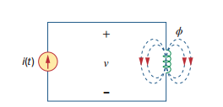




Mutual Inductance
Self Inductance : is an inductance when the voltage induced in a coil by a time-varying current in the same coil.
Let us first consider a single inductor, a coil with Nturns. When current i flows through the coil, a magnetic flux ϕis produced around it .
According to Faraday’s law, the voltage vinduced in the coil is proportional to the number of turns Nand the time rate of change of the magnetic flux ϕ; that is
But the flux ϕis produced by current iso that any change in ϕis caused by a change in the current. Hence, can be written as
or
from 1 & 2 we get:
Inductance for the Inductor

Slide 5
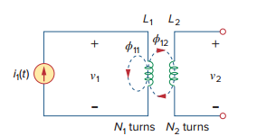
Mutual Indactance
When two inductors (or coils) are in a close proximity to each other, the magnetic flux caused by current in one coil links with the other coil, thereby inducing v oltage in the latter . This phenomenon is known as mutual inductance

